Slide 1
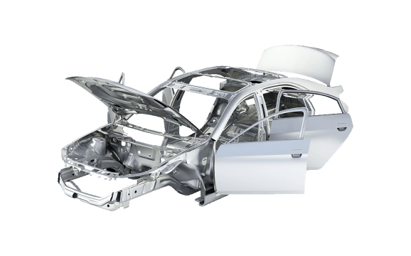
TribiTrabi car parts market
Backend: Kovács Tibor, Hézső Ádám, Kis Benedek
Frontend: Hézső Ádám
Winform app: Kovács Tibor

Slide 2



What purpose does our project serve?
Convenient and easy work environment for administrative staff
Users can browse and purchase hundreds of car parts
Create an enviroment for car fanatics

Slide 3
The road to our steady backend environment
Server side connection
Communication between:
The server and the database
The server and the website
The server and the winform app
Creating REST APIs

Slide 4
What we had in mind for our frontend
Making the design:
•User friendly
•Completely comaptible with our backend
Designing it so it is nice to look at and just as easy to use
Using the latest and most modern version of react.js so its convenient

Slide 5



Backend technologies for TribiTrabi
Server:
NodeJS
Express.JS
Database:
MySQL

Slide 6



Frontend technologies for TribiTrabi
Design:
Figma
Coding:
Bootstrap
JavaScript
CSS
HTML
React

Slide 7

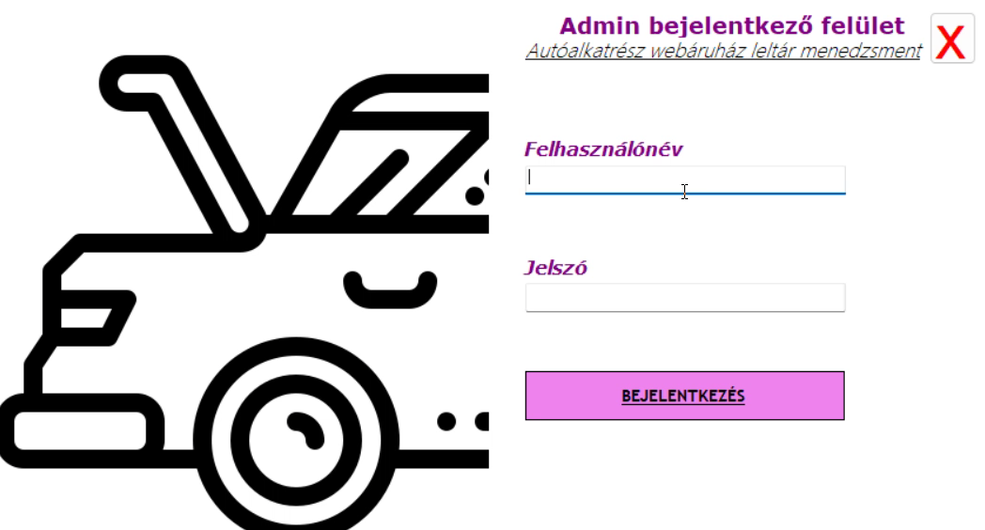
How our winform app works
•Our administrative personnel can log in with their admin user. This happens as follows:

Slide 8
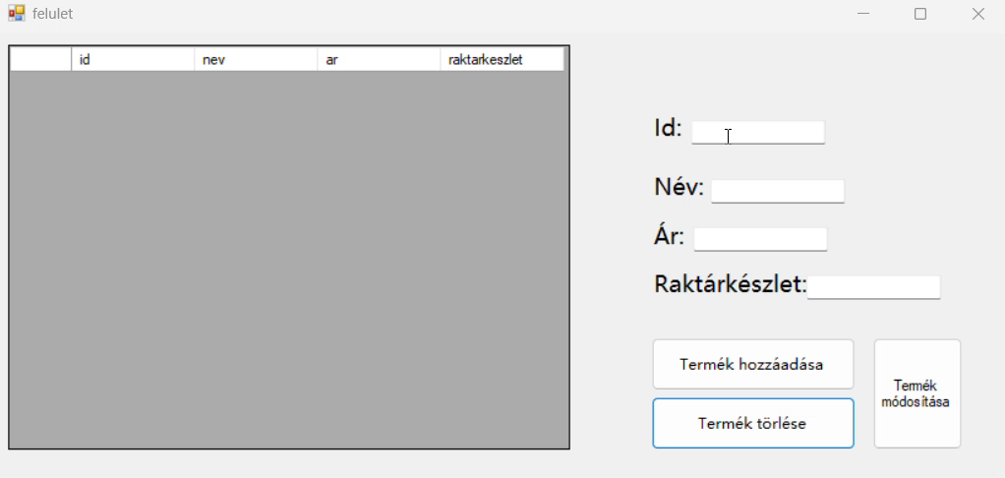
Once the login is succesful, we stumble upon an interface where our admins can add, delete and modify items in our database.Here is how adding an item works:

Slide 9
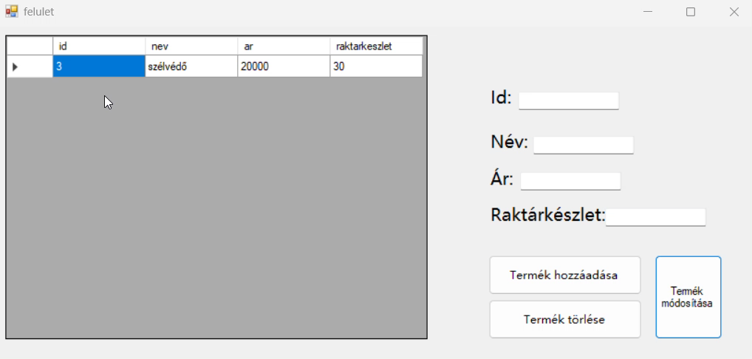
We are also able to delete items from existing in our database by simply selecting our desired item and pushing a button as follows:

Slide 10
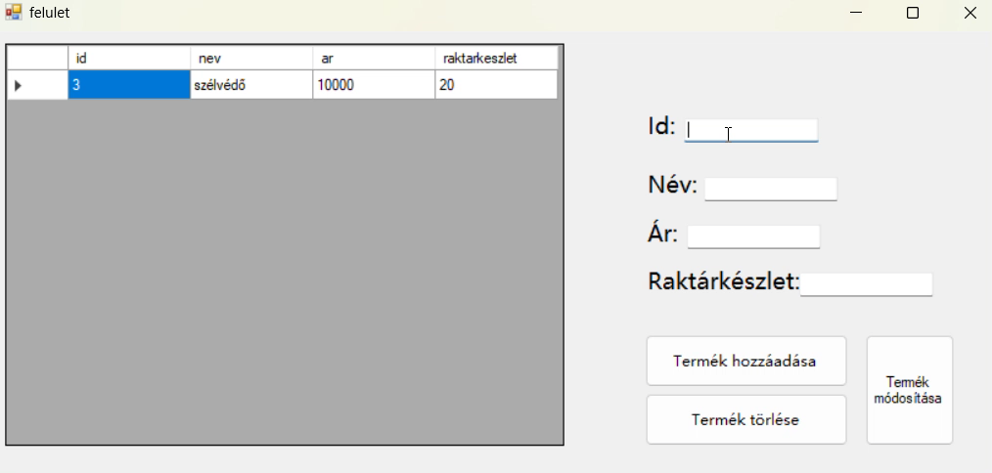
Last but not least, we can modify any item in our database by rewriting its data and pressing „modify item”. This is how it is done:

Slide 11



Introduction of our frontend
We will be going over every function of our website now

Slide 12
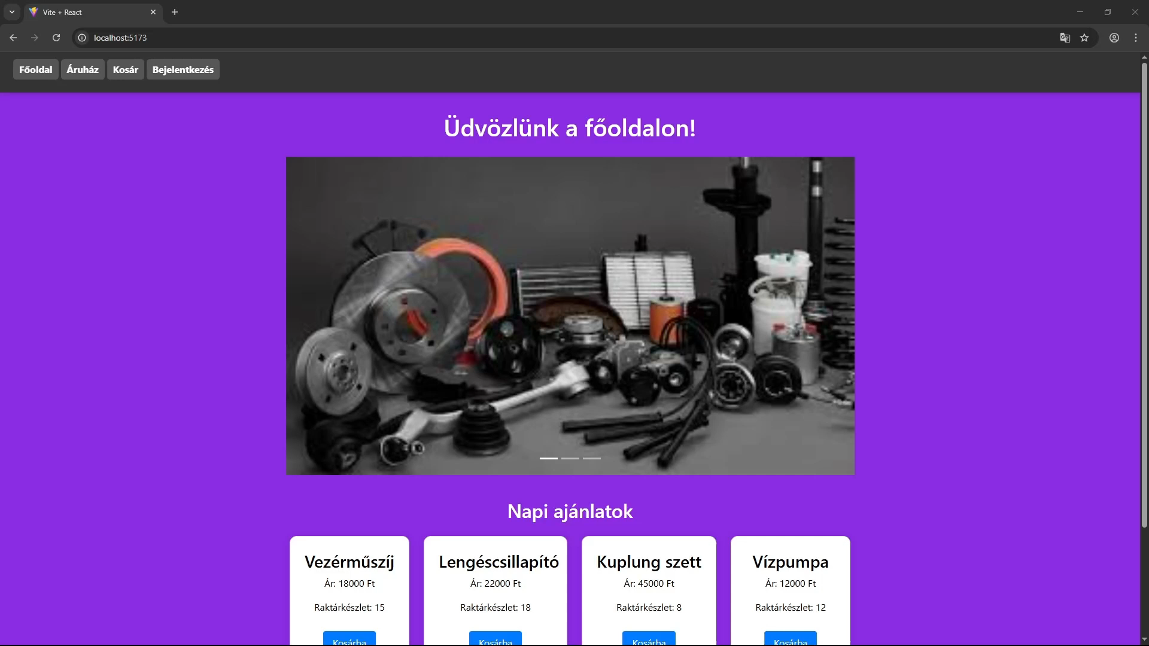
Main page
Our main page displays daily offers of car parts

Slide 13
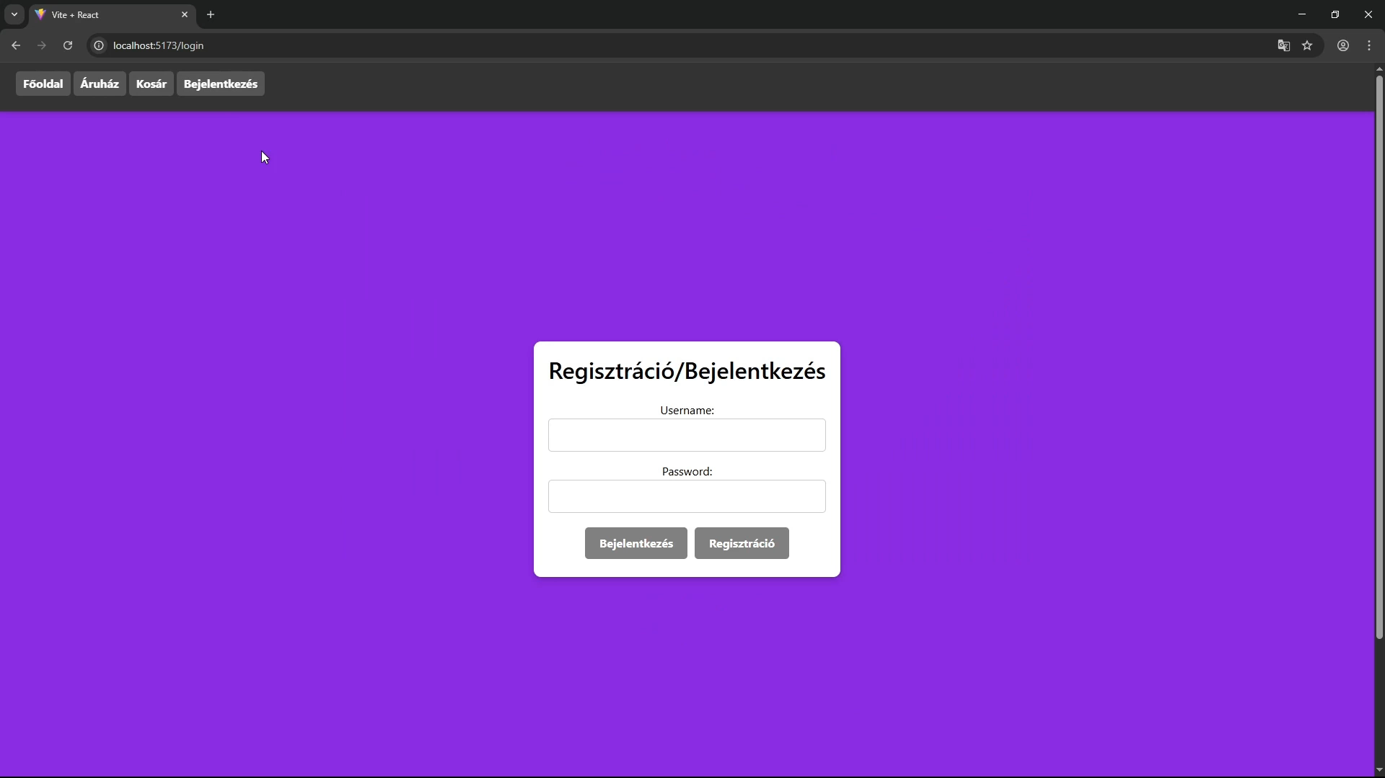
Registration and login
Upon clicking „bejelentkezes” on our header, we are presented with the options of registering and logging in

Slide 14
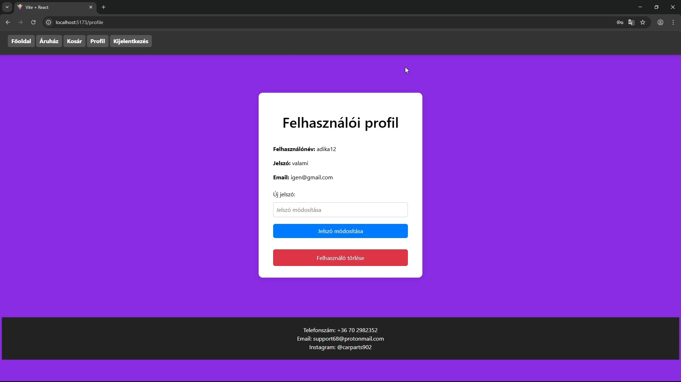
User interface
Check your account information and change your password

Slide 15
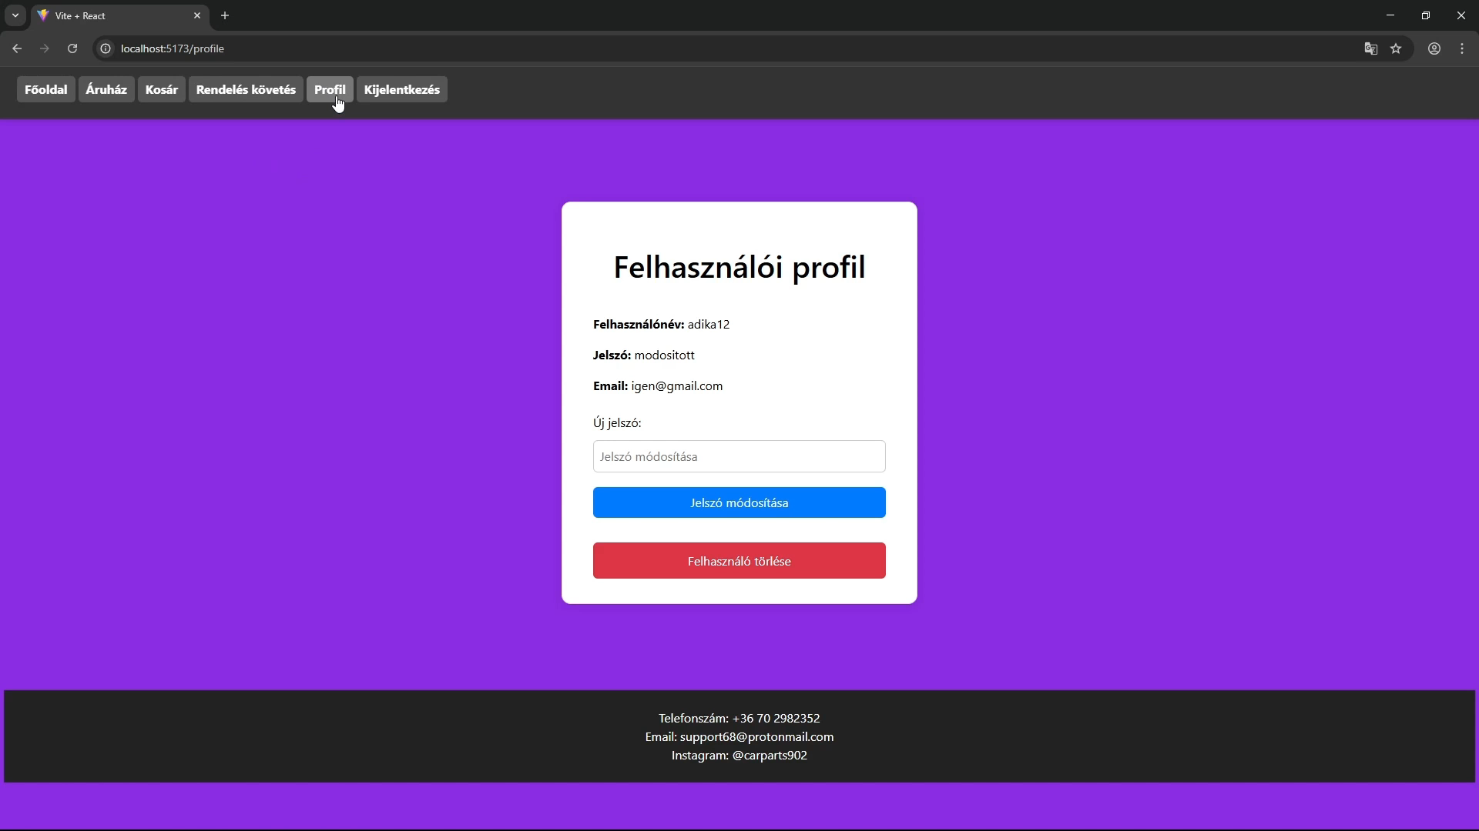
Logging out
Simply log out of your account by pressing a button

Slide 16
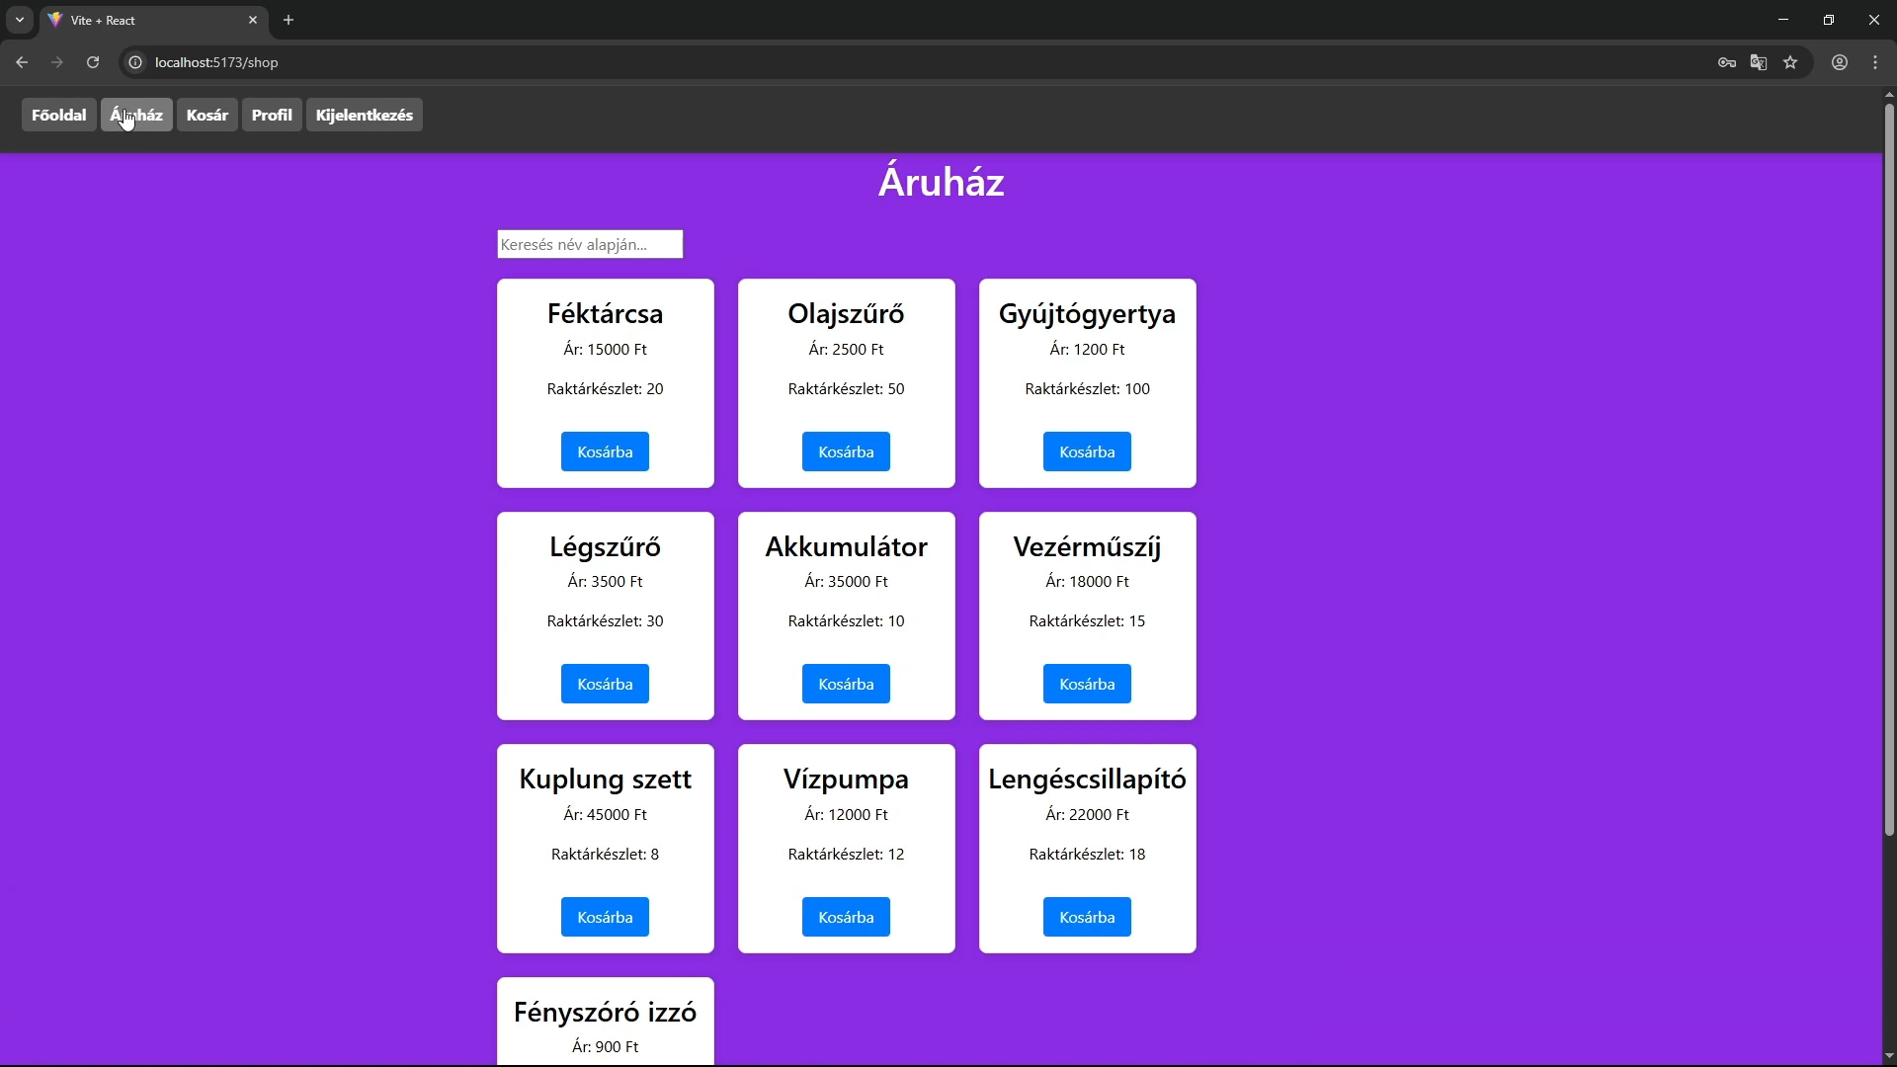
Market
Our market section allows users to search for all available items by typing in a specific name

Slide 17
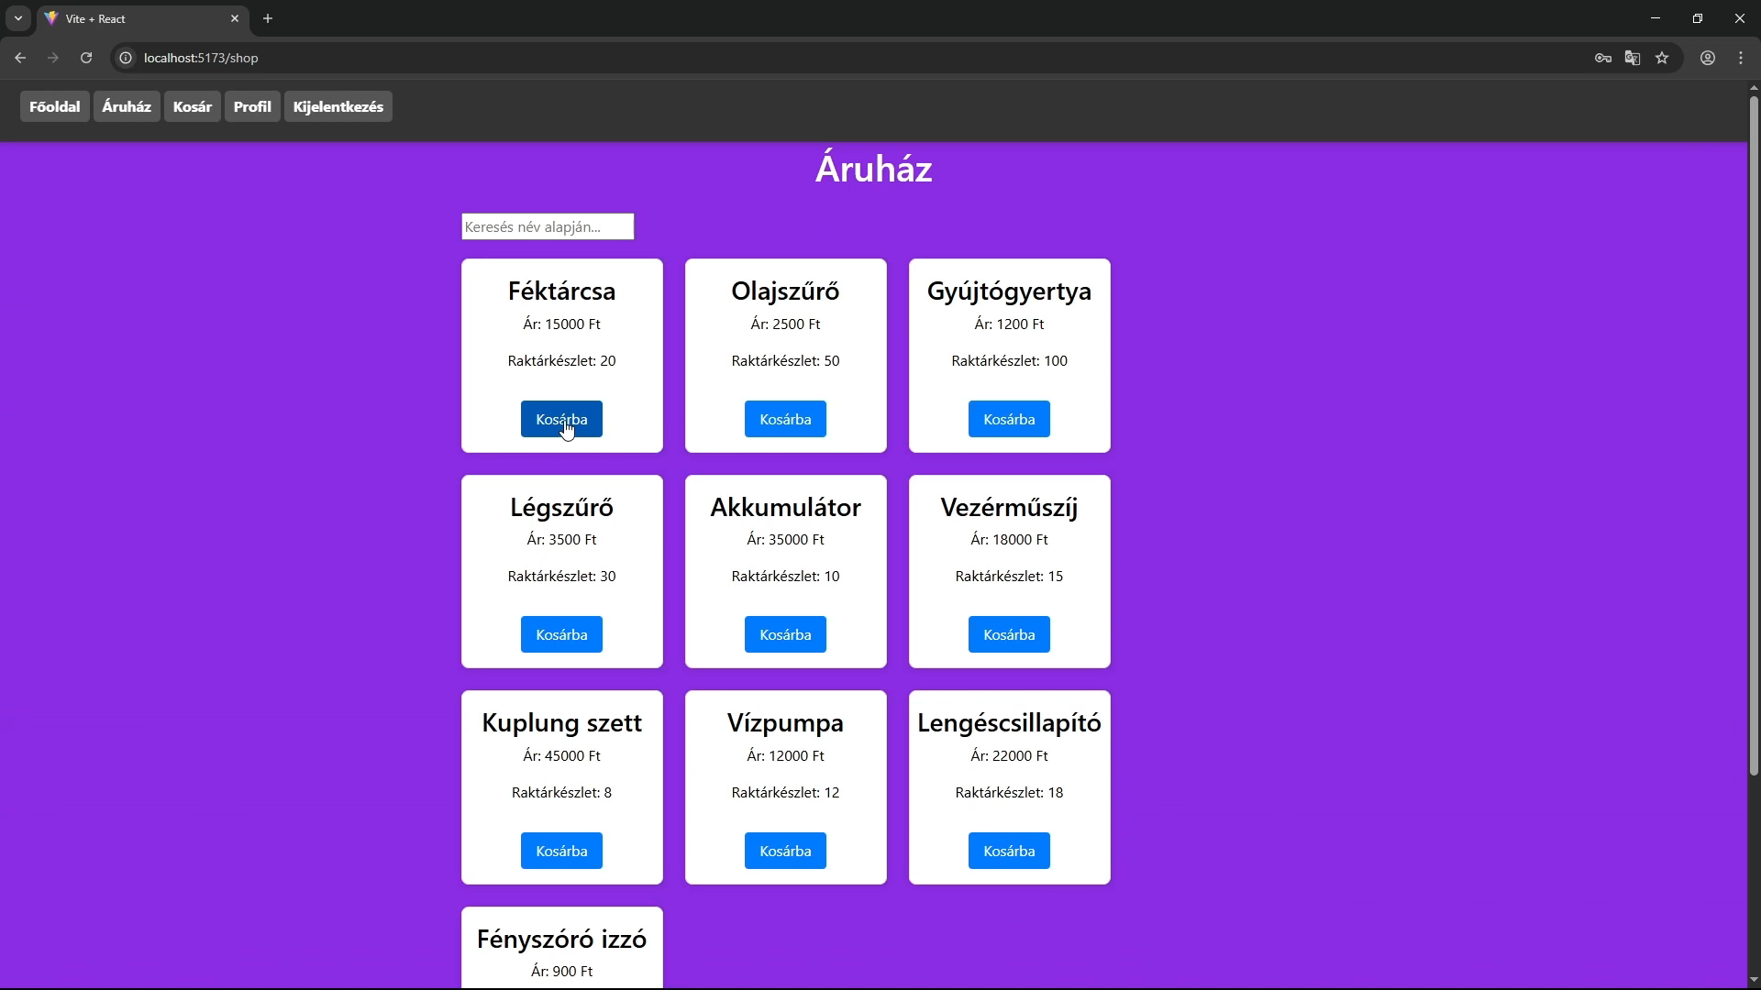
Cart
You are able to remove, decrease and increase the number of items you put in your cart

Slide 18
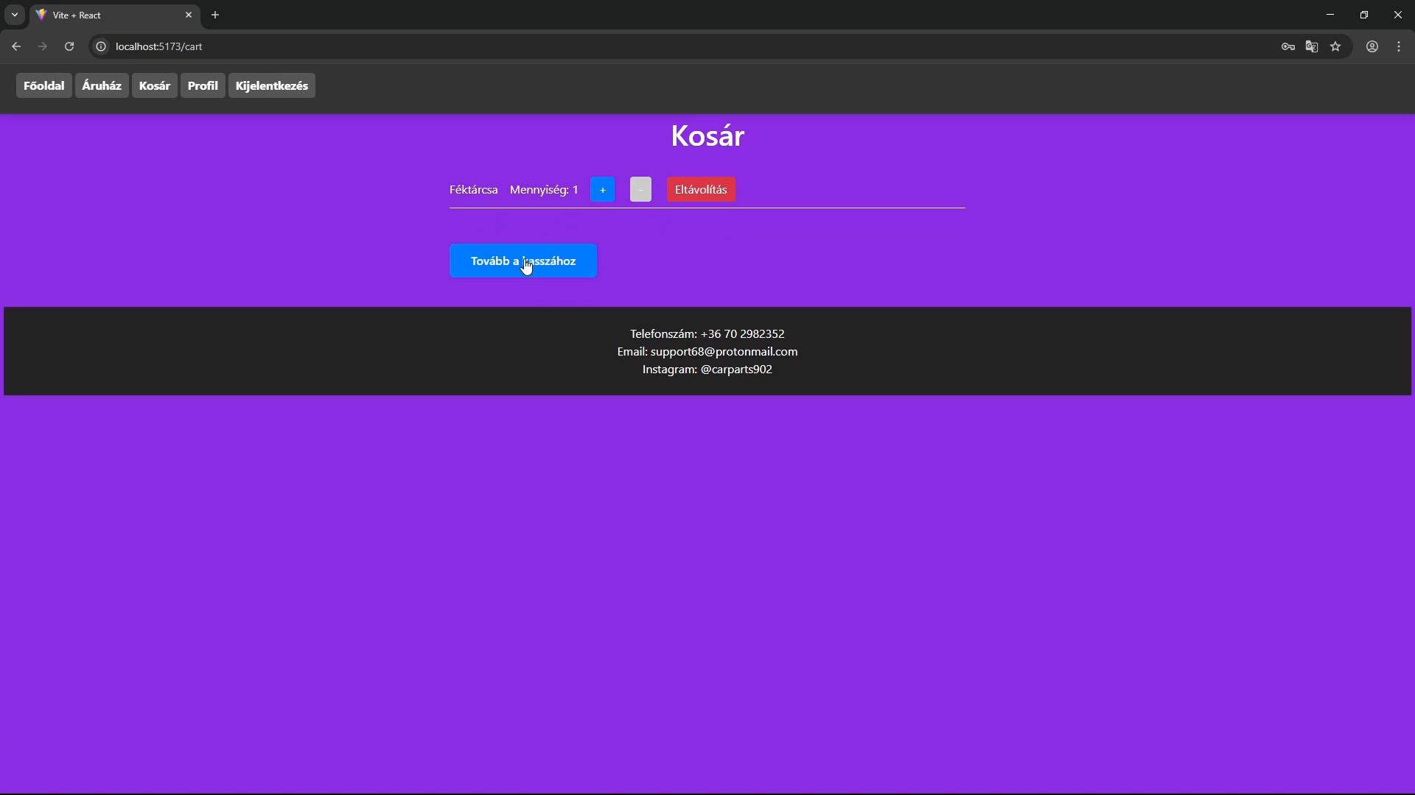
Cart and order
Upon clicking „tovább a kasszához”, you are able to put your billing information and order address into the text boxes

Slide 19
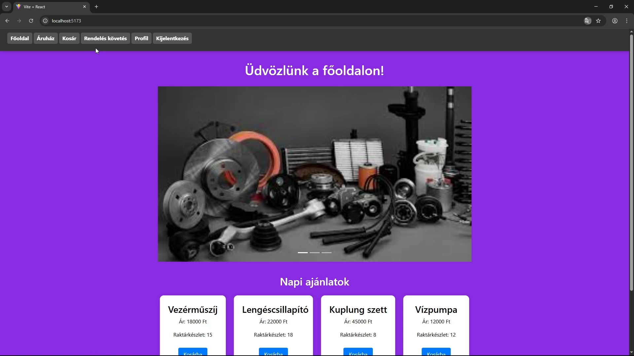
Order tracking
The header of our main page offers an option to track your orders

Slide 20


We kindly thank you for your attention

